Slide 1
Completing Property Tax Reimbursement (PTR) Application
NJ PTR Application Instructions
aka Senior Freeze
Notes:
1

Slide 2
PTR Application Forms Associated with PTR-1 – First Year
The first time an eligible Taxpayer applies for PTR, required forms collect information for prior 2 years
Form PTR-1 – Application form
Form PTR-1A – Completed by tax office to verify property taxes paid for prior two years (must include tax collector stamp) - must be submitted with application if homeowner
Part I completed by applicant
Part II completed by tax collector
Form PTR 1B - Used to verify mobile home park site fees paid for prior two years – must be submitted with application if mobile home owner
Parts I and III completed by applicant
Part II completed by mobile home park owner or manager
2

Slide 3
PTR Application Forms Associated with PTR-2 – Subsequent Years
Once accepted in the PTR program, each year taxpayer must submit forms which validate the taxpayer remains eligible to stay in the program
Forms used for subsequent years in PTR program - Collects data for prior year only
Form PTR-2 - Application form sent to applicant in mail with certain information already pre-printed on form
Form PTR-2a – Completed by tax office to verify property taxes paid for prior year (must include tax collector stamp)
Part I completed by applicant
Part II completed by tax collector
Form PTR 2B – Used to verify mobile home park site fees paid for prior year
Parts I and III completed by applicant
Part II completed by mobile home park owner or manager
3

Slide 4
Before PTR Application is Started
Tax return should be completed before PTR application (needed for income figures)
PTR applications not usually mailed out until mid-February
If tax return completed earlier, taxpayer may have to return to site for help with PTR application
In most municipalities, taxpayer should first go to local tax office for completion & certification of property tax info on Form PTR-1A or PTR-2A. Mobile home owners should have mobile home park owner/manager complete Form PTR-1b/PTR-2b instead
Notes:
In some specific towns, tax office wants most of application completed before taxpayer comes in to get property taxes certified. Consult with your Site Coordinator to see if this applies to your area

Slide 5
Basic Applicant Information & Eligibility Questions (Page 1)
PTR-1 filers must provide all this data for the prior two years (current year – 1 and current year – 2). PTR-2 filers must provide prior year data (current year – 1)
Basic Applicant information (name, address, Social Security number, municipality code)
PTR-2 will have some of this info pre-printed
Marital/Civil Union Status – fill in oval(s) to indicate status on December 31
Age/Disability Status – fill in oval(s) to indicate status as of December 31
Residency Requirements – fill in oval(s) to answer residency questions as of December 31
Notes:
You can obtain municipality code from chart in PTR application booklet or from look-up tool on TaxPre4Free.org Preparer page

Slide 6
Basic Applicant Information & Eligibility Questions (Page 1)
PTR-1 filers must include proof of age or disability with application
Age – copy of birth certificate, driver’s license, church records (baptismal certificate)
Disability – copy of Social Security Award letter
Notes:
Applicants should not send in originals of these documents

Slide 7
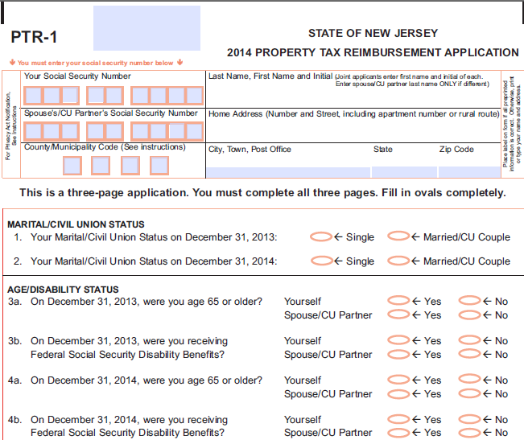
Basic Application Information & Eligibility Questions (Page 1)

Slide 8
Basic Application Information & Eligibility Questions (Page 1)

Slide 9
Income Reporting – What to Include
PTR-1 filers must provide income data for the prior two years (current year – 1 and current year – 2). PTR-2 filers must provide prior year income only (current year – 1)
PTR eligibility income calculation includes all money coming into household, with a few exceptions. (Some income items reported on PTR, but are not reported on NJ tax return)
All Social Security (not just taxable amount) – includes Medicare premiums
Salaries and Wages
Bonuses, commissions and fees
Unemployment
Disability benefits, whether public or private
Interest (both taxable and tax-exempt)
Dividends
Net Capital Gains

Slide 10
Income Reporting – What to Include
(cont’d)
Net Rental Income
Net Profits from Business
Net Distributive Share of Partnership Income & Pro Rata Share of S Corporation Income (out of scope for us)
Support Payments received
Does NOT include child support
Inheritances
Royalties
Fair Market Value of Prizes and Awards
Net Gambling and Lottery Winnings (including NJ Lottery)
Bequests and Death Benefits
Gross Pension and Retirement Benefits (minus taxpayer contributions)
Notes:
State lost court case (Hawe vs. the Director) regarding income worksheet. Now can exclude taxpayer contributions from pension income

Slide 11
Income Reporting – Where to Obtain Data
(cont’d)
PTR income data is obtained from Federal tax return, NJ tax return, and directly from applicant
Can use TaxPre4Free.org link to “NJ PTR Income Categories Tool” to calculate PTR income
Help for each income line specifies where to obtain data
Once data is entered into tool, it will calculate whether applicant meets income eligibility limits
If eligible, copy Income Worksheet data exactly onto income page(s) of application
Same data can be found in “PTR Income Worksheet Sources” document on TaxPrep4Free.org if manual preparation directly on application is preferred
Notes:
Not updated each year until PTR document are available online – late Jan / early Feb:
PTR Income Worksheet Sources document
NJ PTR Income Categories Tool

Slide 12
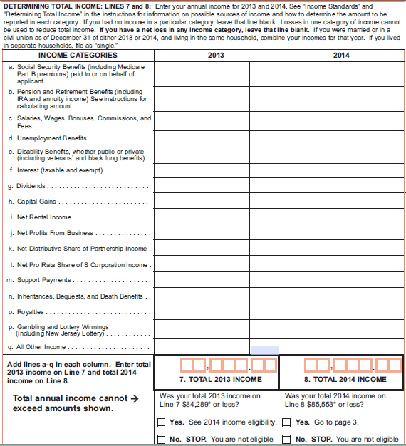
Income Reporting

Slide 13
Principal Residence Information – Last Page
(cont’d)
Fill in information regarding:
Homeowner/Mobile home ownership
Block and lot # of principal residence (on property tax bill or green tax postcard)
Shared ownership of principal residence with someone other than spouse
Reimbursement amount will be pro-rated based on ownership percentage
Principal residence consisting of more than one unit

Slide 14
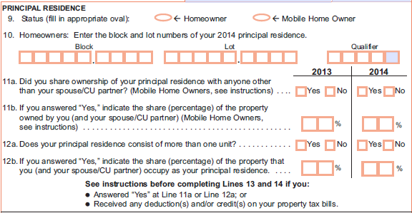
Principal Residence Information – Last Page
(cont’d)

Slide 15
Property Taxes Information – Last Page
(cont’d)
Calculate PTR reimbursement amount:
Enter prior year (current year – 1) property taxes due and paid on principal residence
Obtained from tax collector form, amount in square box. If applicant has not gone to tax collector, do not enter. Tell applicant to enter after tax collector has certified amount
Enter base year property taxes due and paid on principal residence (earliest year in program)
For PTR-1 filers, this is current year – 2 amount reported on this application (from tax collector form, square box)
For PTR-2 filers, base year taxes are pre-printed
Difference between two amounts equals PTR reimbursement amount
If difference is zero or less (i.e. – property taxes have decreased to less than base year), applicant is not eligible for PTR. Do not file application this year – wait a year and file a PTR-1 to get the better base year amount

Slide 16
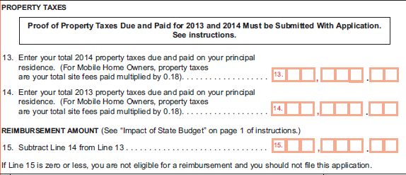
Property Taxes Information – Last Page
(cont’d)

Slide 17
PTR Application for Deceased Resident
(cont’d)
If a person met all eligibility requirements for PTR, but died before filing application, application can be filed by surviving spouse or personal representative
See specific instructions in application booklet for how to complete name and address fields, marital status question, and signature lines in this situation

Slide 18
Completing the PTR Application
(cont’d)
All PTR applications must be quality reviewed
Applicant and spouse must sign and date application in ink
Make copy of completed documents or remind applicants to do so for their records
Application and required documentation should be mailed by applicant in envelope that comes with application booklet
All filers must send proof of property taxes due and paid (Forms PTR-1A or 2A, PTR-1B or 2B)
PTR-1 filers must send proof of age or disability
Notes:
In place of Forms PTR-1A/PTR-2A, applicants may prove that property taxes were due and paid by providing:
Property tax bills for the appropriate years AND
Copies of cancelled checks or receipts for appropriate years OR copies of appropriate Form 1098s received from mortgage company showing amount of property taxes paid out of your escrow account
Residents of co-ops and continuing care retirement facilities must obtain a statement from their management showing their share of property taxes paid for the unit they occupy

Slide 19
Completing the PTR Application
(cont’d)

Slide 20
Property Tax Reimbursement (PTR) – Eligibility
(cont’d)
Income limits are set at an estimated level for application. Limits are frequently lowered once NJ budget is finalized by July 1
Income limits are same for single and married (since 2007)
If taxpayer’s income is between finalized limit & original estimated limit, should still apply. Will not receive check for that year, but can establish/maintain base year for future reimbursements & ensure receiving application for following year

